Slide 1
Remote Rendering VU Echtzeit-Visualisierung
David Pfahler and Bernhard Rainer

Slide 2
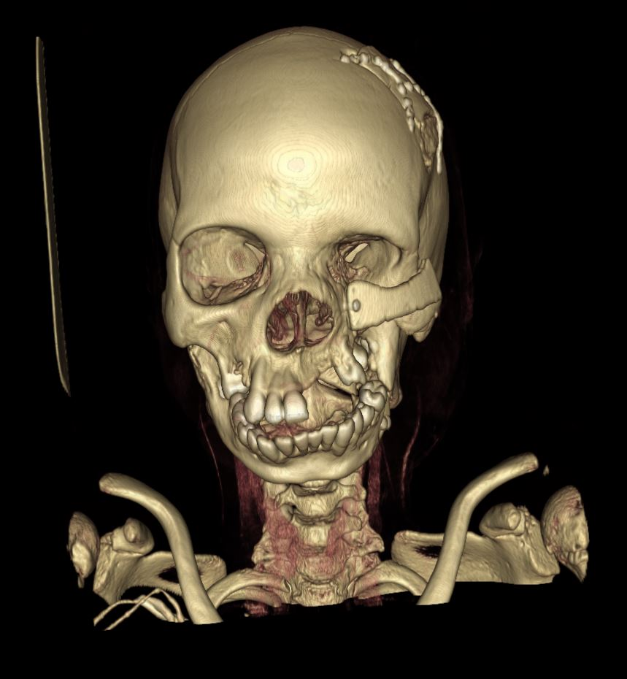
Motivation
Huge volume data sets
Portable devices for patient communication (Tablets …)
Computational Expensive Shaders

Slide 3
Outline
Screen Tiling
Network Communication in Unity
Demo

Slide 4
Outline
Demo!!
Screen Tiling
Network Communication in Unity

Slide 5
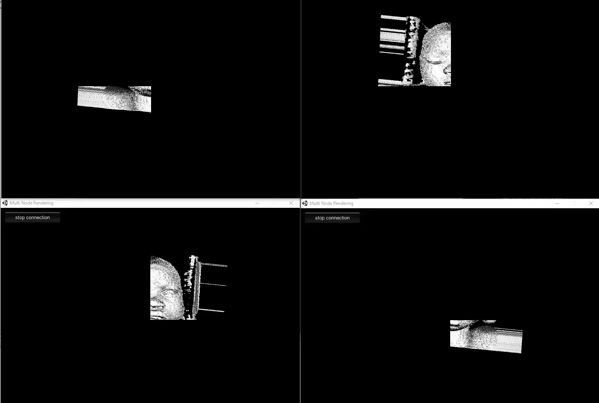
Results – Client Nodes

Slide 6
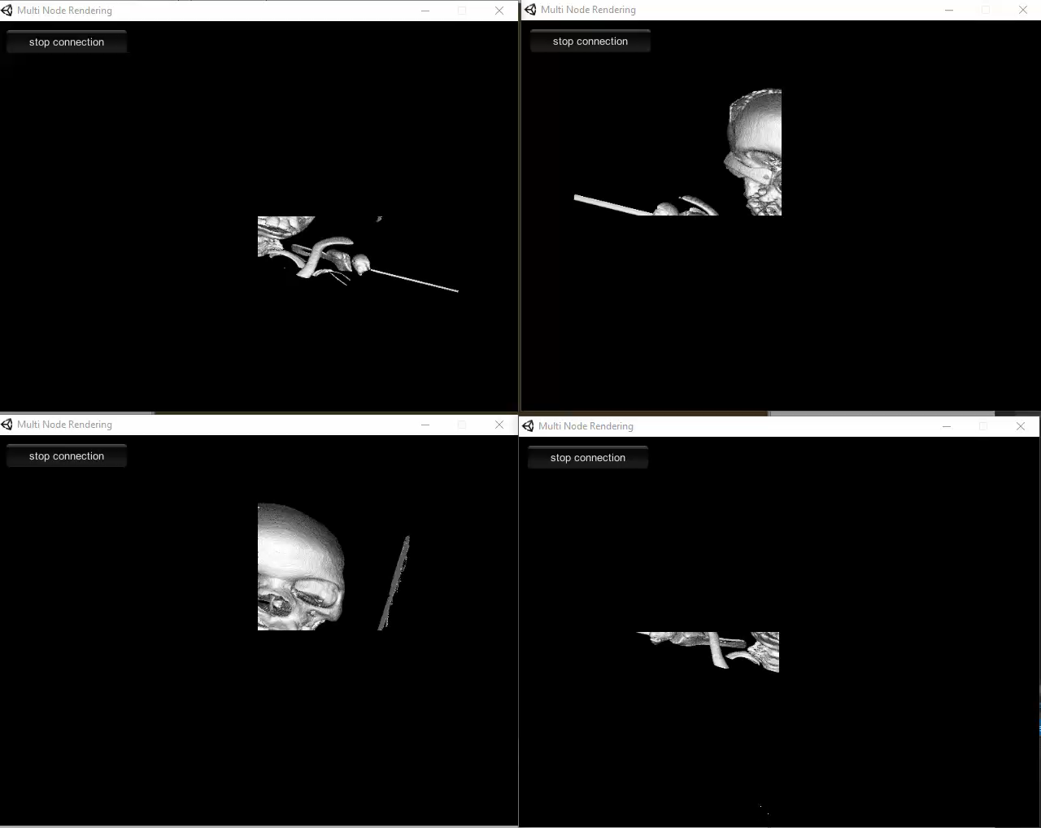
Results – Client Nodes

Slide 7
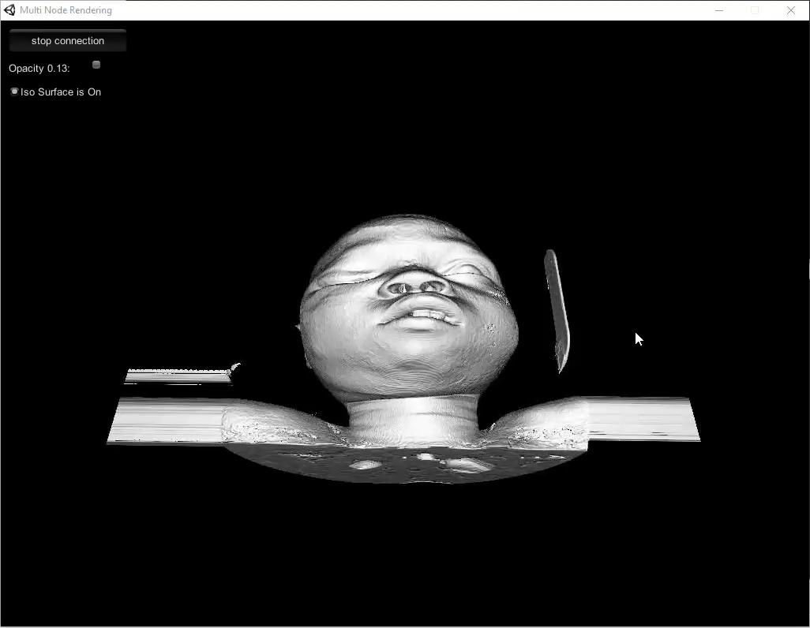
Results - Server

Slide 8
Outline
Demo
Screen Tiling
Network Communication in Unity

Slide 9
Screen Tiling
Screen is divided into a number of (regular) tiles
Each tile is rendered separately by a render node
Rendered tiles are sent back to the server, who composes the rendered image

Slide 10
Screen Tiling
Problem: How to render correctly projected
geometry only onto a part of the screen?

Slide 11
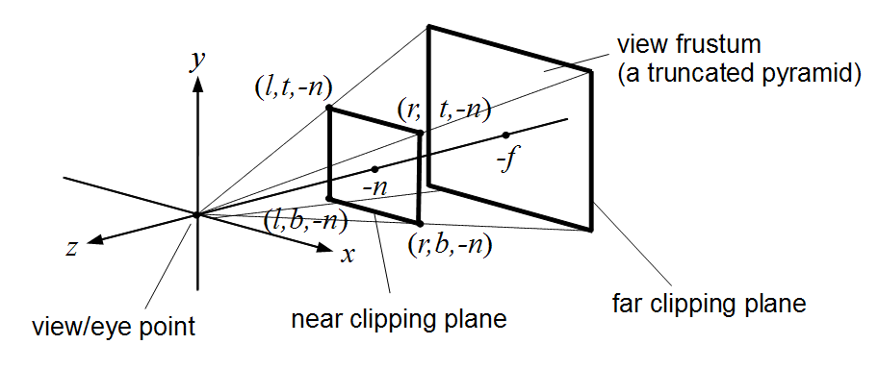
Screen Tiling
Oblique perspective projection
Creates asymmetric view frustum
Uses left, top, bottom and right parameter scaling the near plane

Slide 12
Screen Tiling
How can we translate our usual perspective projection into an oblique projection?
top = np * tan(fov)
bottom = -top
left = bottom * aspect
right = top * aspect
Scale parameters to address only certain parts of the screen.
For example: Render left half of the screen: right = 0

Slide 13
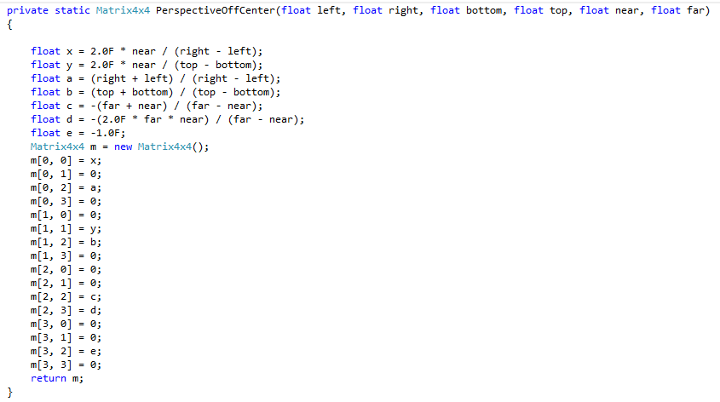
Screen Tiling
Thanks Unity!!!! ☺☺☺
http://docs.unity3d.com/ScriptReference/Camera-projectionMatrix.html

Slide 14
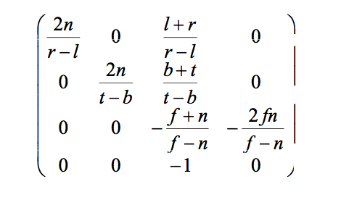
Screen Tiling

Slide 15
Screen Tiling
Set size of render target to the size of the tile
Render your scene
Perform sophisticated culling
Composing the image
Render scaled and biased full screen quads to the render target
For example: left half of the screen
(0,0),(0.5,0),(0.5,1,)(1,0)

Slide 16
Screen Tiling
In our application we perform a simple raycast
Render bounding box into buffers using the oblique projection
Perform per pixel raycast with full screen quad on the render target

Slide 17
Outline
Demo
Screen Tiling
Network Communication in Unity

Slide 18
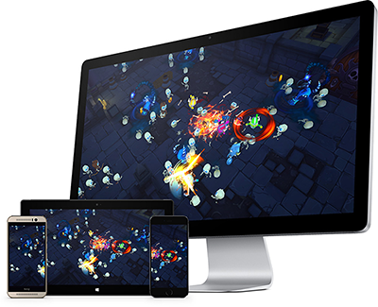
Network Communication
High level scripting API
Super simple ☺
Only UDP ☹
Low Level API
More Configuration possibilities ☺
But complex ☹

Slide 19
Network Communication
//create configuration containing one reliable channel m_CommunicationChannel = m_Config.AddChannel( QosType.UnreliableFragmented);
Relatively easy channel configuration.
Also possible to configure maximal number of connections.

Slide 20
Network Communication – Node Connect
Composer
Node 1
Node 2
…
Node N
Init Node
Connect
Set Tile
Set Tile
Set Tile

Slide 21
Network Communication – Composing
Composer
Node 1
Node 2
…
Node N
Change
Set Parameter
Block next Change for x ms
Set Texture

Slide 22
Conclusions
Transfer of Textures over Network is the Bottleneck
Help with Blocking for some time
We were not able to test it with a big render grid but it worked well with 4 render nodes

Slide 23
Thank you for the attention

